Slide 1
Anticipating future image from video stream
Project Progress
-Ahnaf Farhan

Slide 2
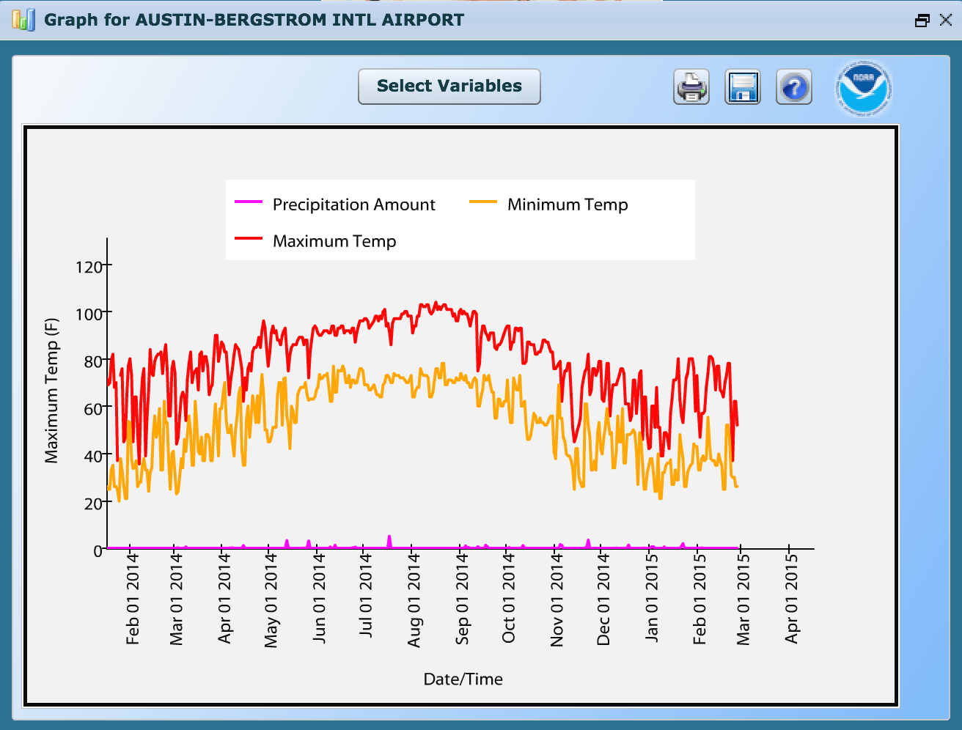
Problem
Weather Prediction
Data of current and previous atmosphere
What about visual prediction?
Video streams of constant location

Slide 3
Proposed Methodology
Frame (Tn-1)
Generate vector representation of Image.
Extract visual semantics from vector space representation of Image.
Using frames from video stream of same place anticipate future frame attributes.
Frame (Tn-2)
CNN
Frame (Tn)
.
.
.
Image vector from fully connected layer
Frame (Tn-x)

Slide 4
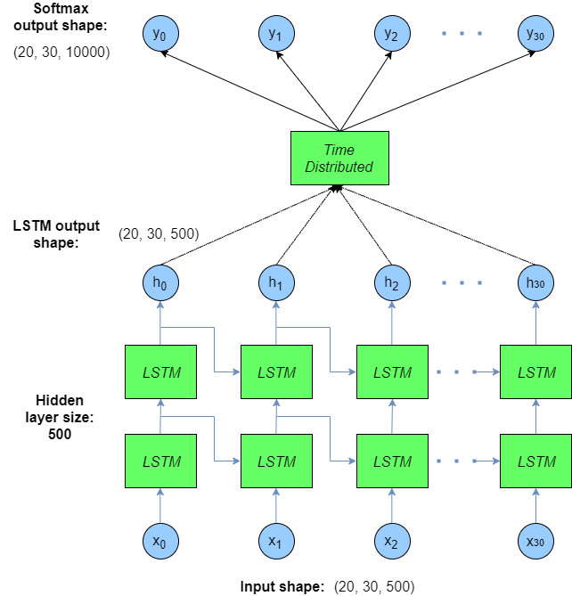
Current Methodology
LSTM - Recurrent Neural Network
Model time-sequence dependent behaviour
Feeding back the output of a neural network layer at time t to the input of the same layer at time t+1

Slide 5
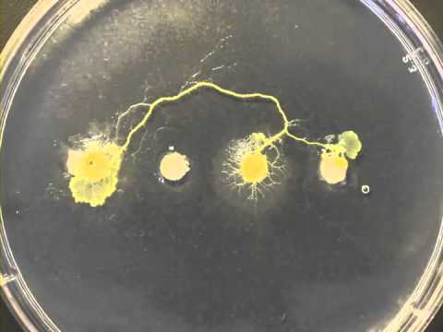
Data

Slide 6
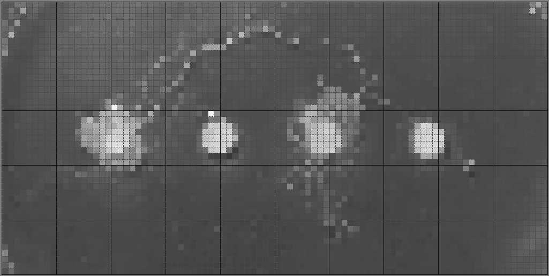
Input

Slide 7
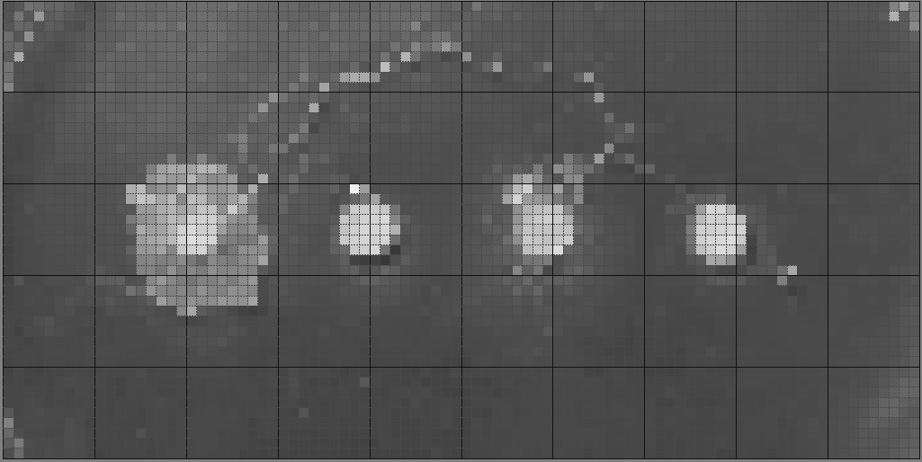
Output Expected

Slide 8
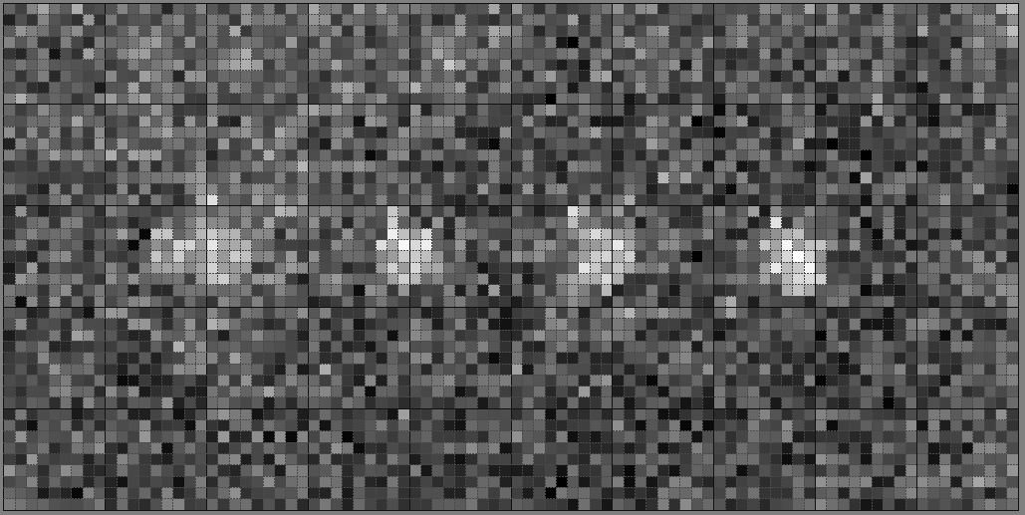
Output Actual

Slide 9
Analysis and Future Direction
Problem:
Sampling and Normalizing the images
Solution:
Do not train the whole image
Find region of interest
Train the region of interest seperately

Slide 10
Find region of interest

Slide 11
Working Plan
Approval
28th November
Implemented LSTM
1 - 3rd December
Evaluation
4th
December
Final Presentation
5th
December

Slide 12
Thank You
Any Questions

Slide 13
A Visual Embedding for Extraction of Semantics from Image
Project Proposal
-Ahnaf Farhan

